Slide 1

마르세休

Slide 2

01
기업 소개

Slide 3

Save Your Energy, Rave Your Dream.

Slide 4



Vision
Revolution
혁신적인 기술을 통해 소비자에게 시간을 선물하는 기업
Eco
제품 생산, 운송 과정에서 생분해 포장지를 사용하는 친환경 기업
Close
소비자 목소리에 귀 기울이며 먼저 다가가는 기업

Slide 5






조직도
CEO: 조성민
고객 관리
회계
해외영업
마케팅
기획
팀장: 김동현
팀장: 박준미
팀장: 탁동우
팀장: 강다영
팀장: 이아름

Slide 6



기업정보
마르세休
경기도 수원시 영통구 삼성로 129
031.456.123
@official_mareusehyu
e-mail: Mareuisehyu73@naver.com

Slide 7
02
제품 소개

Slide 8
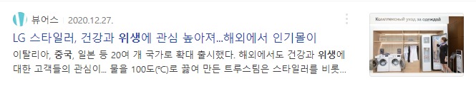

제품 선정 이유
COVID-19로 인해 개인 위생개념이 증가하여 건조기 판매량 증가

Slide 9

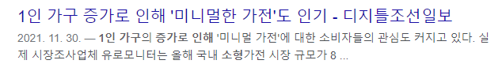
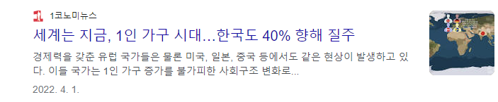
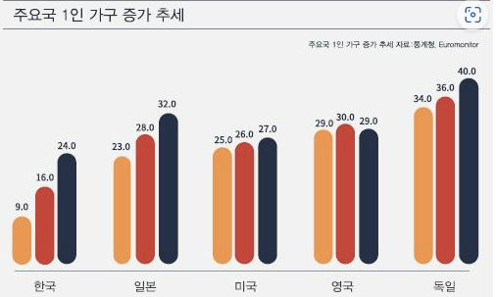
제품 선정 이유
1인 가구 증가로 1인 가구 특성상 부피가 작은 소형가전 선호

Slide 10
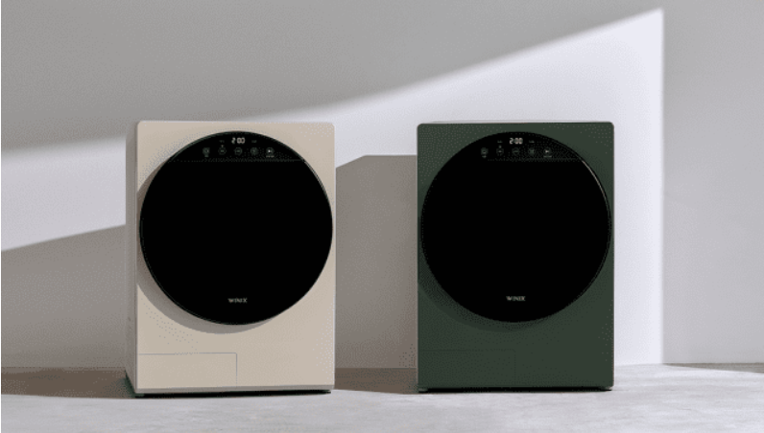
제품 선정
“休드림 미니 건조기”
‘’
40분 이내의 짧은 건조 시간!
1인 가구 맞춤형 용량 ‘4kg’의 미니 건조기

Slide 11
제품 소개
유해세균 최대 99.9% 살균
건조기 소음 인증 기준 업계 최저소음
국내생산 및 3년 무상 품질 보증
에너지소비효율등급 1등급
작은 사이즈와 다양한 색깔의 트랜디한 디자인

Slide 12
제품 소개
’2030년 탄소피크, 2060년 탄소중립목표 선언’
친환경 브랜드에 대한 지원 가속화 마르세休 적용

Slide 13
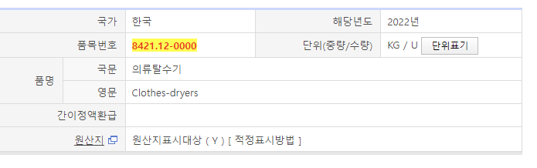
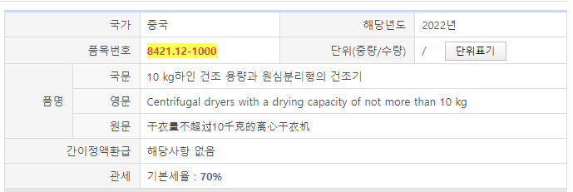
제품 선정
HS CODE
‘’

Slide 14
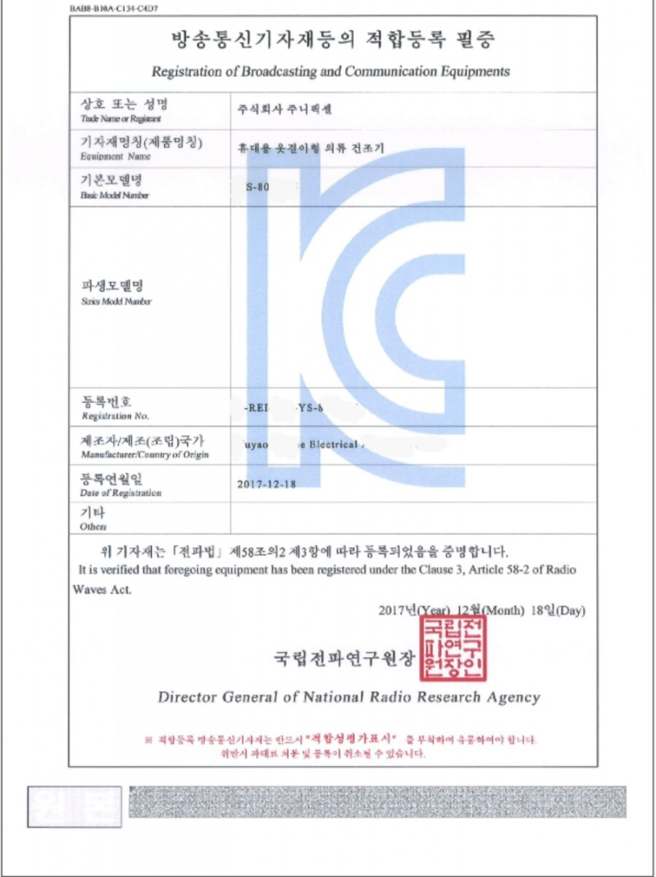
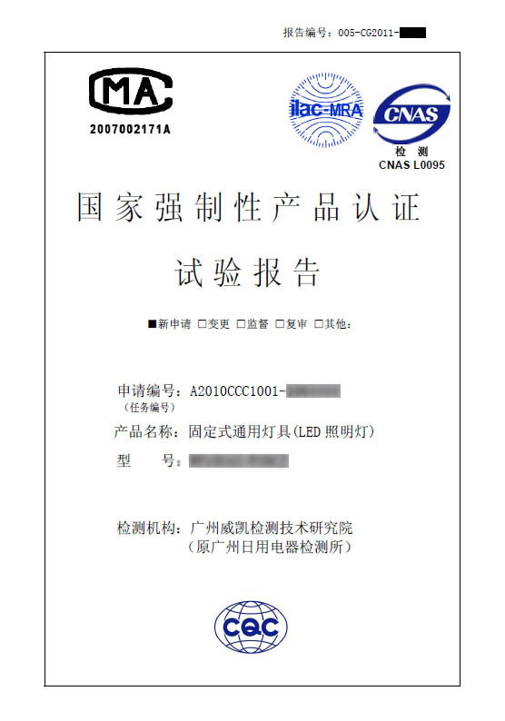

품질검사 인증서
‘’
KC인증
중국 CCC인증

Slide 15
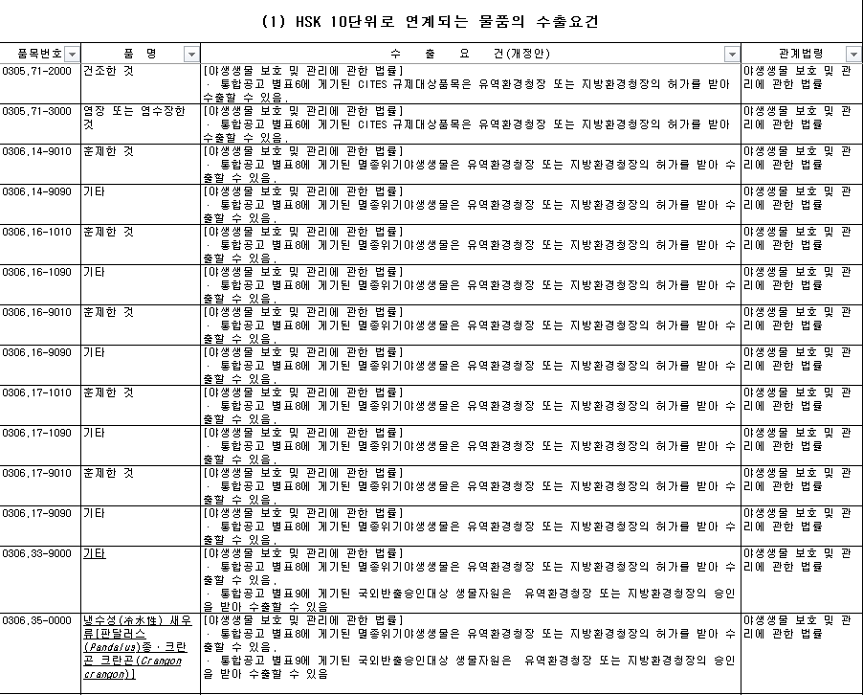
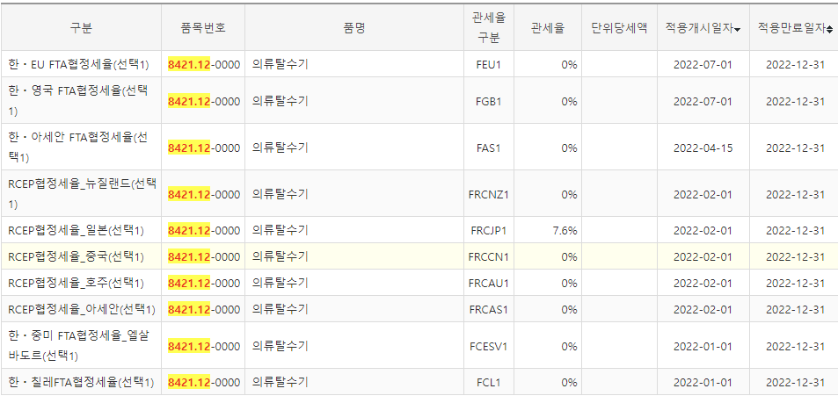
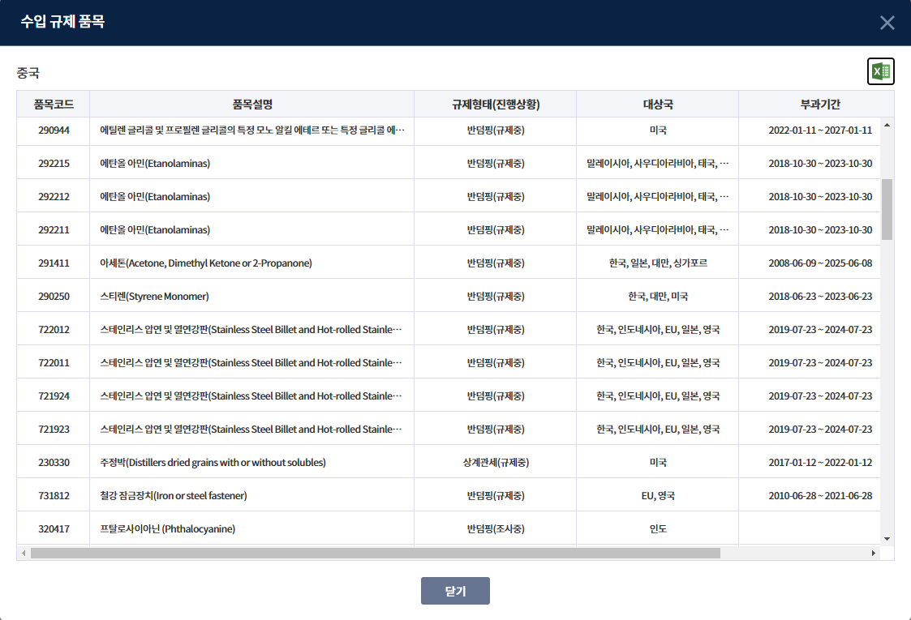
제품 수출 가능 여부
‘’
수입국 관세 한-중 FTA: 관세0%
한국 수출요건 해당 사항 없음
중국 수입 요건: 해당 사항 없음

Slide 16
03
수출국 선정

Slide 17

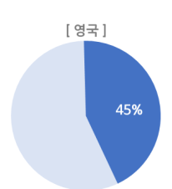
영ㅇ
중국 선정 이유
출처: KOTRA
영국의 건조기 보급률은 45%
영국 내 가격 경쟁률 치열
영국 자사 제품 구매율이 높다.

Slide 18
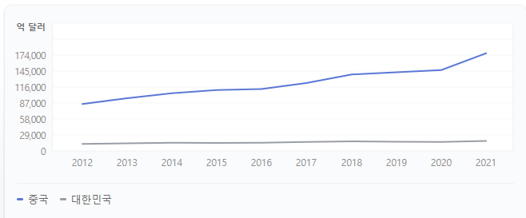
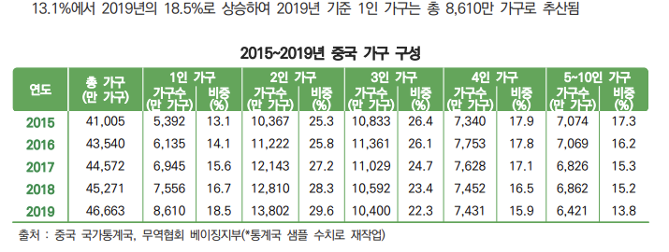
수출국 선정 이유
중국 GDP 상승
1인 가구 꾸준히 증가

Slide 19
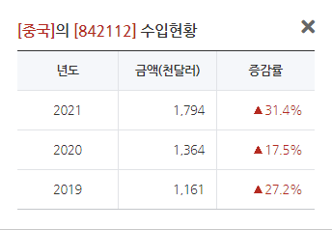
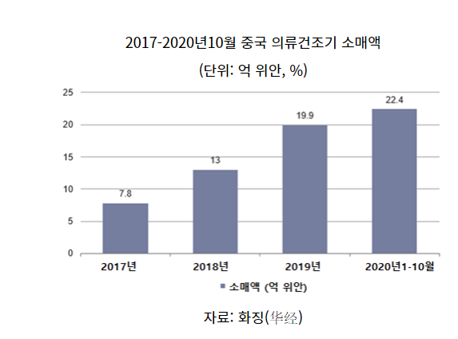
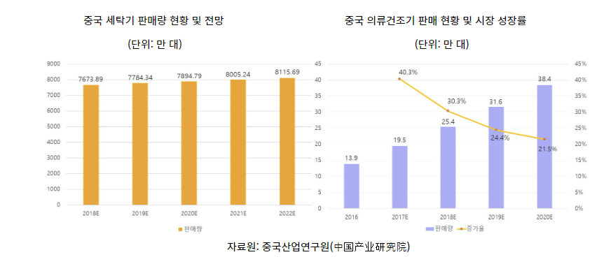
수출국 선정 이유
출처: 한국무역협회

Slide 20
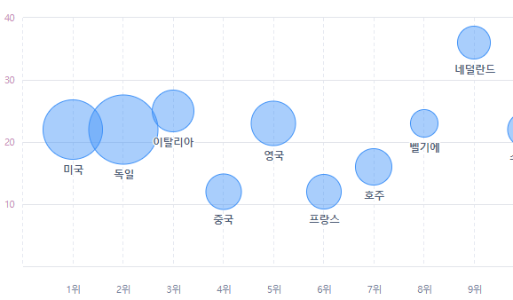
수출국 선정 이유
품목 수입금액: $140,972
한국 수출금액: $25,683
중국의 해당품목 수입국가 수 12

Slide 21

수출국 선정 이유
출처: KOTRA
중국 의료건조기 시장은 발전 초기 단계
시장보급율은 6%불가
그러나!!
미국90%,유럽 60%비해 성장 가능성이 매우 큼
2020년 코로나19 사태로 건강의 중요성 부각
살균, 악취 제거 등의 기능을 갖춘 건조기 제품 주목

Slide 22
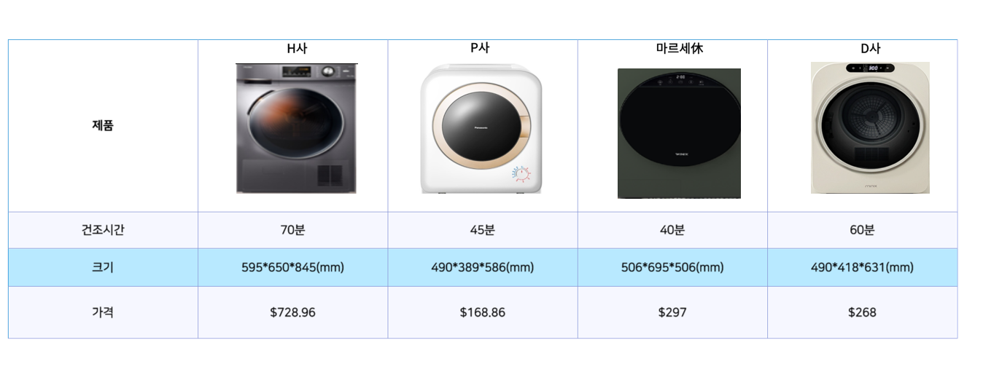
중국내 경쟁사 비교

Slide 23
04
진출 전략 및 마케팅

Slide 24
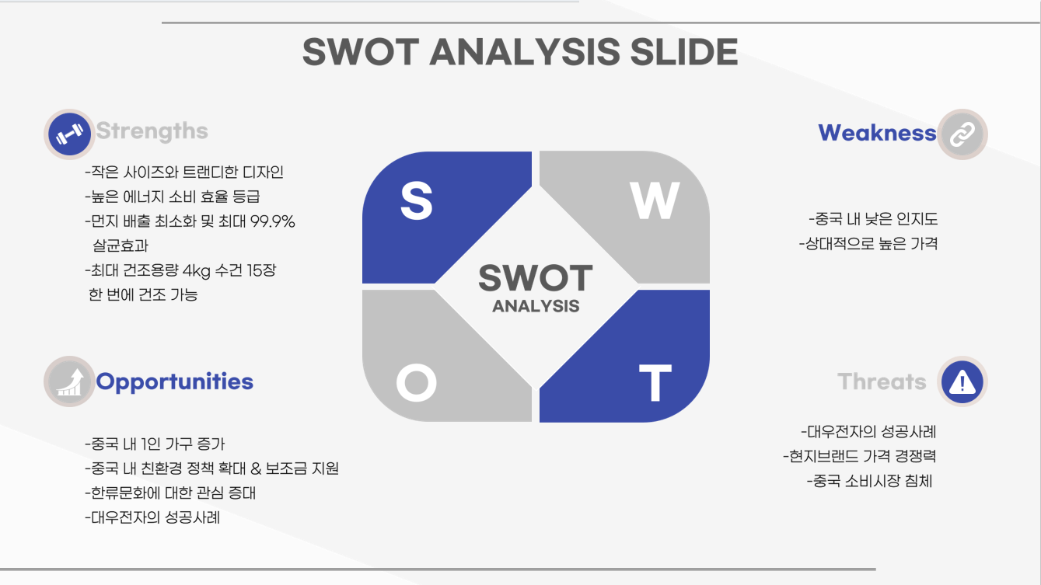
SWOT 분석

Slide 25

SWOT 분석
“S-O전략”
1. 증가하는 1인가구를 타켓으로 하는 미니 건조기
2. 친환경 정책에 부합하는 높은 에너지 소비효율등급

Slide 26
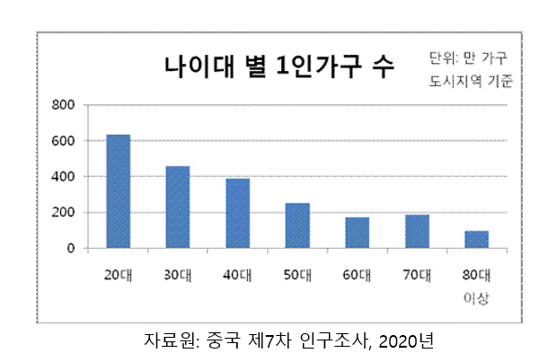
STP-Segmentation

Slide 27
STP-Segmentation

Slide 28
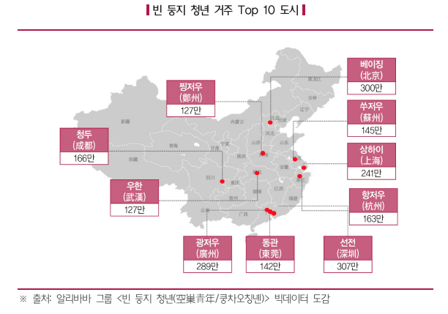

STP-Segmentation

Slide 29
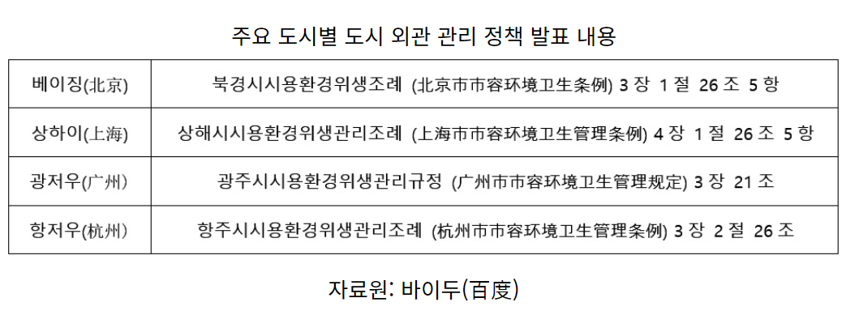
STP-Targeting

Slide 30
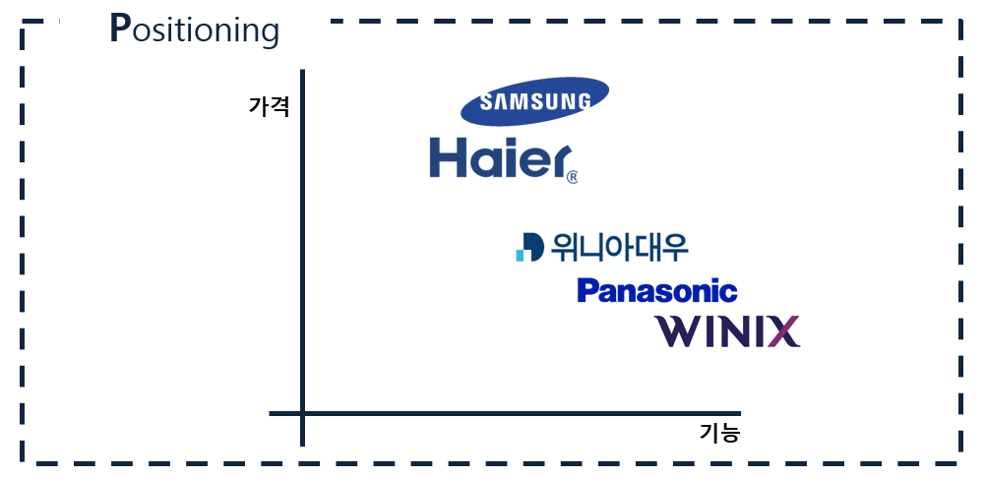

STP-Positioning
마르세休

Slide 31
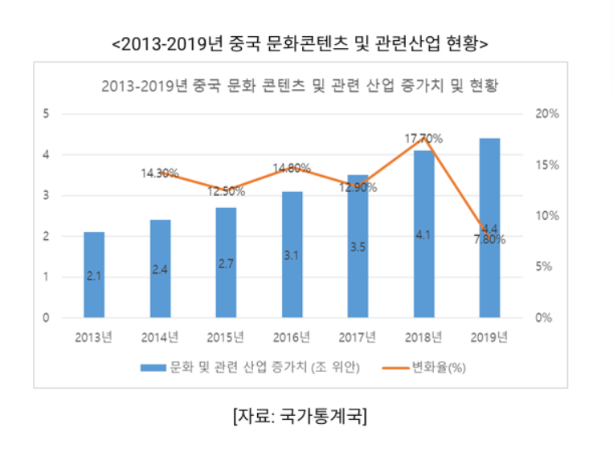

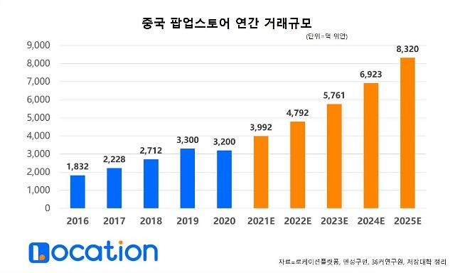
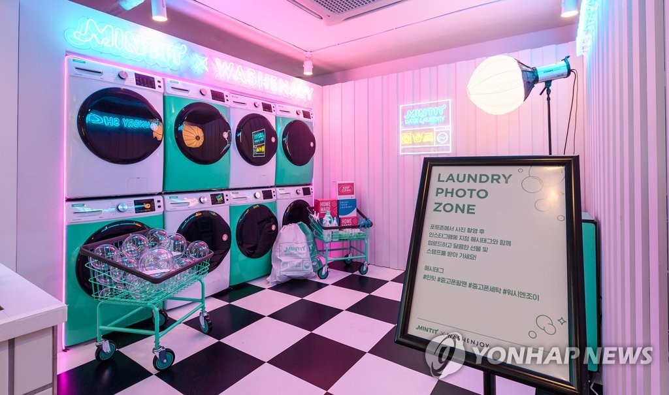
마케팅 전략
1) 왕홍과 협력을 통해 중국 SNS플랫폼으로 홍보
*왕홍: 온라인상의 유명인사
2) 1인가구 비중이 높은 지역에 팝업스토어 개점

Slide 32
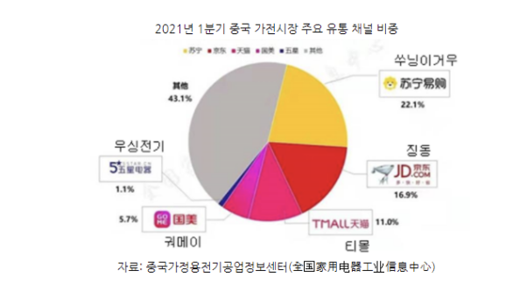


유통 채널
온라인 유통 채널
전 제품 온라인 판매
다량의 소비자에게 제품을 홍보 유리

Slide 33







유통 과정
마르세休
공장
선적
소비자
소매업자
도매업자
수입업자

Slide 34
05
바이어 발굴

Slide 35
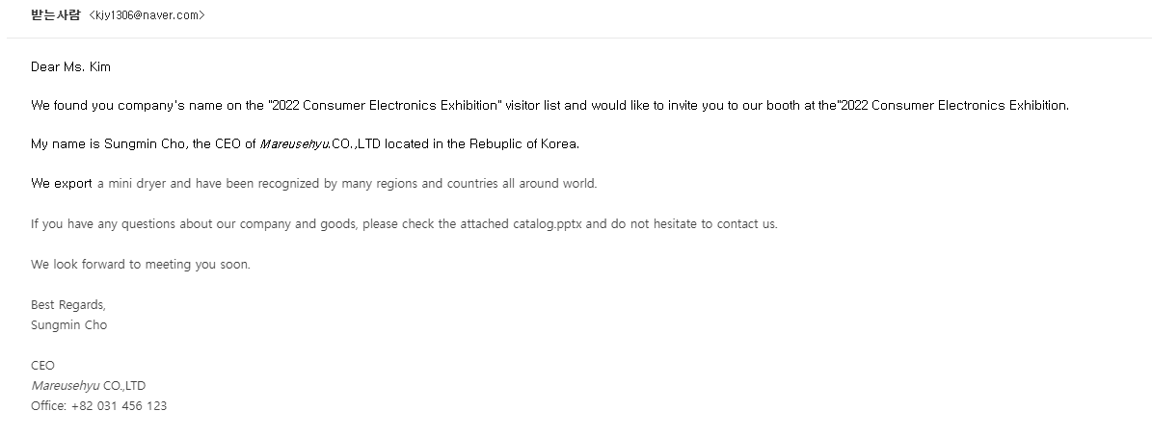
전시회 초대

Slide 36
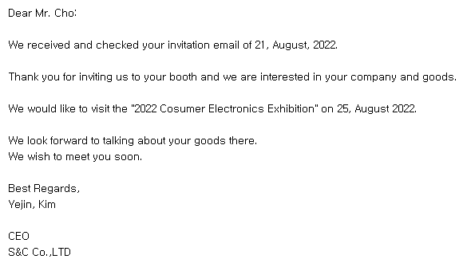
전시회 초대

Slide 37
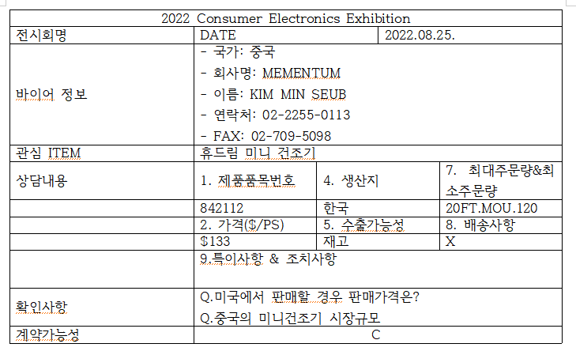
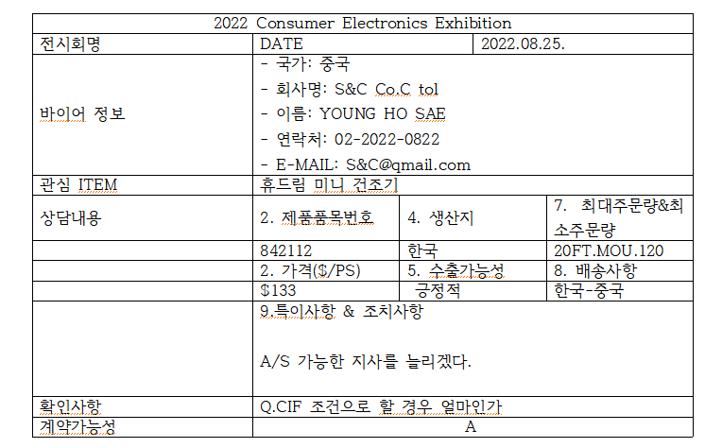
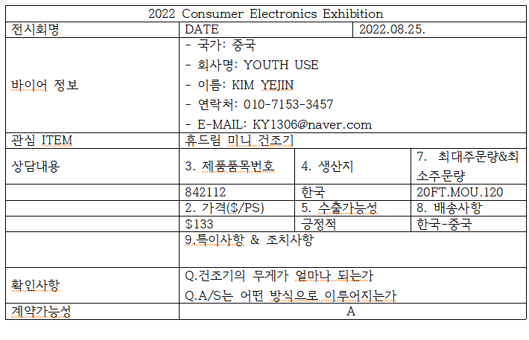
해외 전시회 상담일지

Slide 38
유통 과정
49.58%
마르세休
공장
선적
$88.89
EXW $132.96
FOB
$133
CIF
$133.04
소비자
소매업자
도매업자
수입업자
$297
$228.44
$198.65

Slide 39
수출액
수출량 & 수입량
수출마진 & 수입마진
수출량: 40ft X 80 → 20000개
수출액: 2,660,0000$
수출마진: 881,600,$ → 49.58%
수입마진: 916,800 → 30%
소비자가격
소비자가격: 297$

Slide 40
06
무역 서류

Slide 41
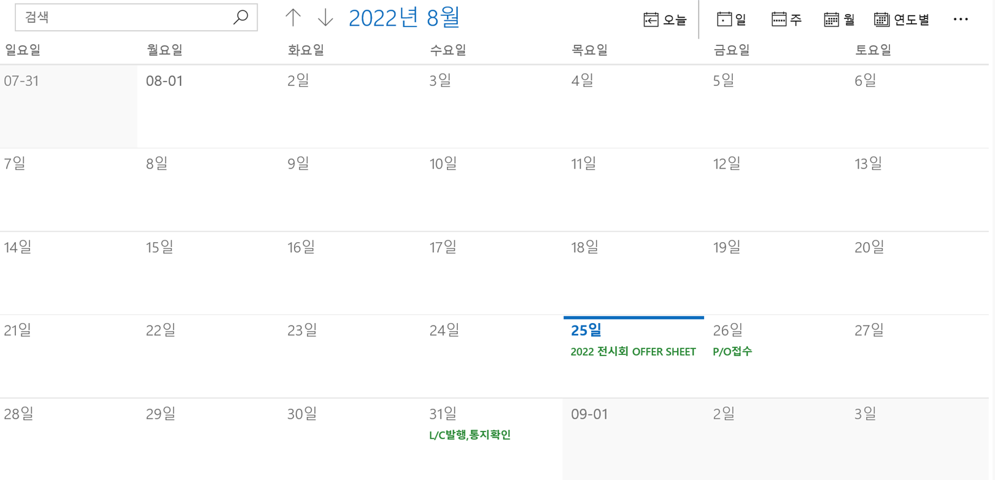
무역 서류 흐름

Slide 42
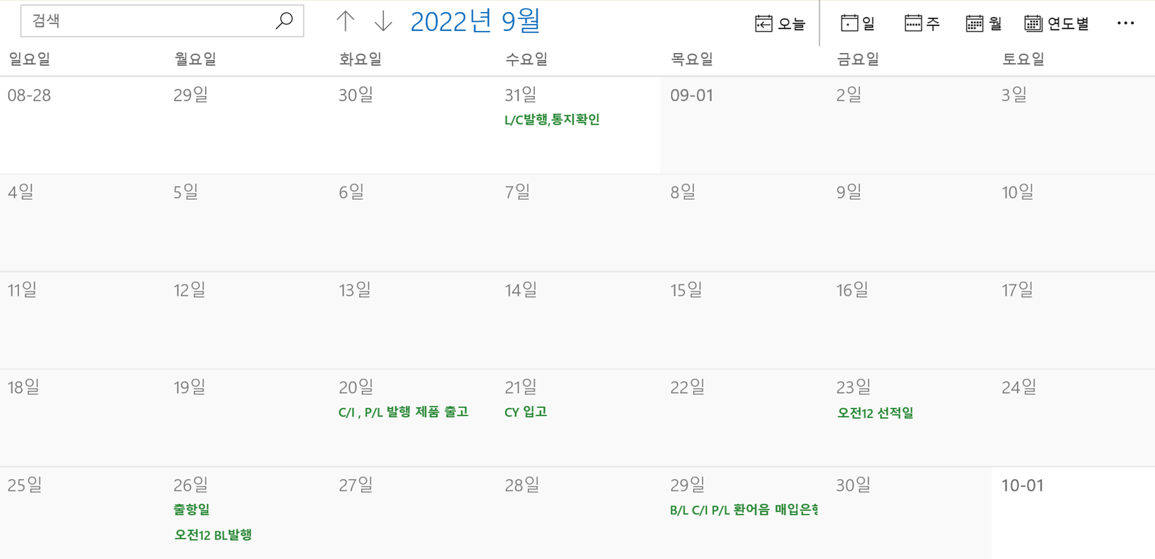
무역 서류 흐름

Slide 43
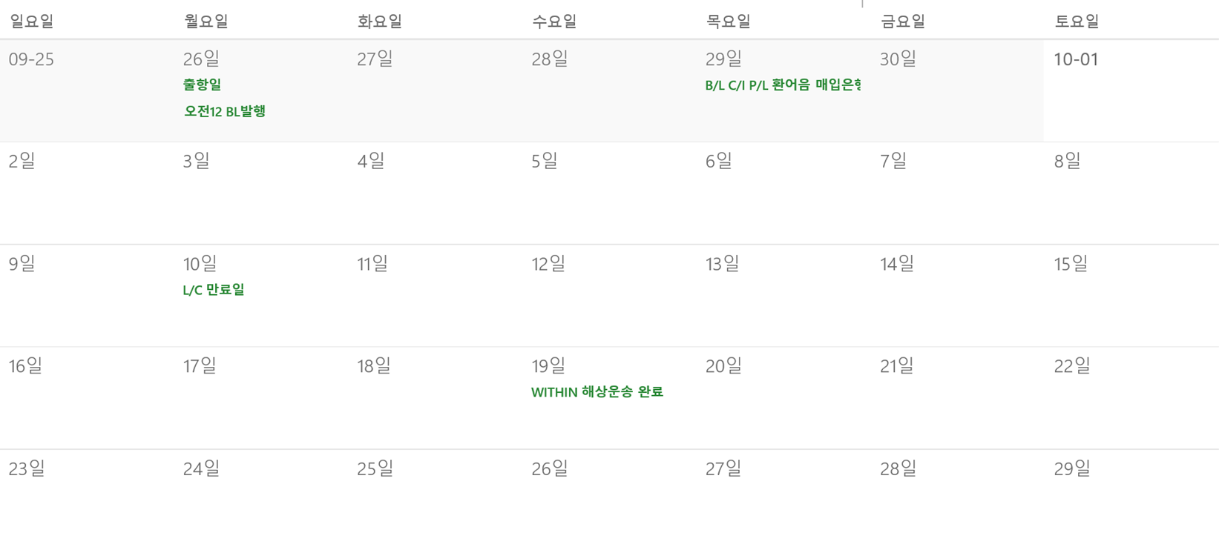
무역 서류 흐름

Slide 44
MARESEHYU CO., LTD
OFFER SHEET
Messrs : S&C CO., LTD. |  | Our Ref. | TR220825-1
No. 60, Mansan Road, jangnyeong Distirct, Shanghai City, China 200336 |  | Date | AUGUST 25, 2022
Origin | Republic of Korea
Shipment | Within 30days after receipt of your L/C
Loading Port | Incheon, Korea
Destination | ShangHai, China
Packing | Export Standard Packing
Payment | By an Irrevocable L/C at sight
Validity | September 15, 2022
Advising bank | IBK BANK INCHEON BRANCH
OFFER SHEET

Slide 45

OFFER SHEET
Unit : FOB INCHEON IN USD/PC
No. | Commodity & Description | Q’ty | U/Prc | Amount
1 | hyu dream mini drying machine(organic white) | 10,000ea | $133 | $1,330,000
2 | hyu dream mini drying machine(organic green) | 10,000ea | $133 | $1,330,000
TOTAL |  | 20,000ea |  | $2,660,000
Accepted by S&C CO., LTD. H.S Myeong / CEO | Maresehyu Co., Ltd
PRESIDENT SUNG MIN CHO

Slide 46
P/O
S&C CO., LTD. |  | PURCHASE ORDER
Messrs. |  | P/O No. | DV20220826-1
Maresehyu Co., Ltd |  | Date | Aug 26.2022
Description | hyu dream mini drying machine(organic white)
 | hyu dream mini drying machine(organic green)
Packing | Export Standard Packing
Quantity | 20,000pcs
Price terms | FOB Incheon, KOREA
Unit Price | $133

Slide 47
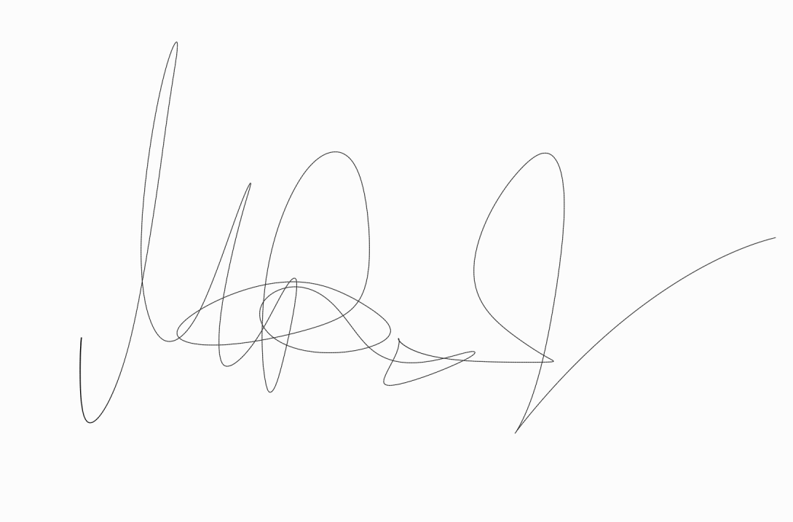
Amount | USD2,660,000 | Authorized by | Authorized by
Loading Port | Incheon, Korea | Authorized by | Authorized by
Destination | Shanghai, China
Payment | By an Irrevocable L/C at sight | Authorized by | Authorized by
Shipment | Within 22.09.30
Remarks |  | Authorized by | Authorized by
 |  | Authorized by | Authorized by
 |  | Authorized by | Authorized by
 | Authorized by
Authorized by S&C CO., LTD. H.S Myeong / CEO | Authorized by | Authorized by | Authorized by
P/O

Slide 48
SWIFT L/C
SWIFT L/C
IBK BANK SUWON BRANCH Received from THE Bank OF CHINA SHANGHAI BRANCH ** :40A form of documentary credit : IRREVOCABLE ** :20 documentary credit no.: MGK220825. ** :31C date of issue : Aug. 31, 2022 ** :40E applicable Rules : UCP LATEST VERSION ** :31D date and place of expiry : 221010 KOREA ** :50 applicant : S&C CO., LTD No. 60, Mansan Road, jangnyeong district, Shanghai City, China 200336

Slide 49
SWIFT L/C
SWIFT L/C
** :59 beneficiary : Maresehyu Co., Ltd 129, Samsung-ro 277beon-gil, Yeongtong-gu, Suwon-si, Gyeonggi-do, Republic of Korea ** :32B currency code amount : ** US Dollar 2,660,000(USD 2,660,000) ** :41D available with/by-name. address : ANY BANK BY NEGOTIATION ** :42C drafts at : DRAFTS TO BE DRAWN AT SIGHT FOR FULL INVOICE VALUE

Slide 50
SWIFT L/C
SWIFT L/C
** :42D drawee name and address : The Bank of CHINA Shanghai branch ** :43P partial shipments :**PROHIBITED** ** :43T transshipment :**PROHIBITED** ** :44E loading/dispatch/taking charge at/from : INCHEON PORT, KOREA ** :44F Port of Discharge/Airport of Destination : SHANGHAI, CHINA ** :44C Latest date of ship : 220930 ** :45A description of goods and/or services : HYU DREAM mini drying machine 10,000ea at USD133.00 PRICE TERM: FOB INCHEON TRADE TERMS: FOB INCHEON

Slide 51
SWIFT L/C
SWIFT L/C
** :46A documents required + SIGNED COMMERCIAL INVOICE IN TRIPLICATE. + SIGNED PACKING LIST IN TRIPLICATE + FULL SET OF CLEAN ON BOARD OCEAN BILLS OF LADING AND THREE NON NEGOTIABLE MADE OUT TO THE ORDER OF THE BANK OF CHINA AND MARKED FREIGHT COLLECT AND NOTIFY APPLICANT

Slide 52
COMMERCIAL INVOICE
COMMERCIAL INVOICE
Shipper / Exporter Maresehyu Co., Ltd 129, Samsung-ro 277beon-gil, Yeongtong-gu, Suwon-si, Gyeonggi-do, Republic of Korea SUNG MIN CHO +82)02-6343-3968 | Sailing on/or about | No. & Date of Invoice CI20220825 20 SEP, 2022
Sailing on/or about | Sailing on/or about | No. & Date of L/C MGK S20220825 31 AUG, 2022
For Account & Risk of Messrs S&C CO., LTD. No. 60, Mansan Road, jangnyeong district, Shanghai City, China 200336 HO SE MYUNG Tel: +86) 21-2202-0822 | Sailing on/or about | L/C Issuing Bank THE BANK OF CHINA, No. 23, zongshan 1st road, Huangpu district, Shanghai city, China 200002
Notify Party Same as above | Sailing on/or about | Remarks H.S Code:8421121000 TRADE TERMS: FOB INCHEON
Port of Loading INCHEON, KOREA | Final Destination SHANGHAI, CHINA | Sailing on/or about
Carrier HMM VESSEL 888 | Sailing on/or about 2022. 09. 26 | Sailing on/or about

Slide 53
Port of loading | Final Destination | ///////////////////////////////////////////////////// Signed by | ///////////////////////////////////////////////////// Signed by |  | ///////////////////////////////////////////////////// Signed by | ///////////////////////////////////////////////////// Signed by | ///////////////////////////////////////////////////// Signed by
INCHEON, KOREA | SHANGHAI, CHINA | ///////////////////////////////////////////////////// Signed by | ///////////////////////////////////////////////////// Signed by |  | ///////////////////////////////////////////////////// Signed by | ///////////////////////////////////////////////////// Signed by | ///////////////////////////////////////////////////// Signed by
Carrier | Sailing on or about
HMM VESSEL 888 | 26-SEP-22
Marks and No | Description of Goods | QUANTITY | ///////////////////////////////////////////////////// Signed by |  | Unit Price | AMOUNT | ///////////////////////////////////////////////////// Signed by
 | HYU DREAM mini drying machine(ORGANIC GREEN) | 10,000EA | ///////////////////////////////////////////////////// Signed by |  | $133 | $1,330,000 | ///////////////////////////////////////////////////// Signed by
 | HYU DREAM mini drying machine(ORGANIC WHITE) | 10,000EA | ///////////////////////////////////////////////////// Signed by |  | $133 | $1,330,000 | ///////////////////////////////////////////////////// Signed by
 | Total | 20,000EA | ///////////////////////////////////////////////////// Signed by |  |  | $2,660,000 | ///////////////////////////////////////////////////// Signed by
///////////////////////////////////////////////////// Signed by
Maresehyu CO.LTD
PRESIDENT SUNG MIN CHO

Slide 54
PACKING LIST
PACKING LIST
Shipper / Exporter Maresehyu Co., Ltd 129, Samsung-ro 277beon-gil, Yeongtong-gu, Suwon-si, Gyeonggi-do, Republic of Korea SUNG MIN CHO +82)02-6343-3968 | Sailing on/or about | No. & Date of Invoice CI20220825 20 SEP. 2022
Sailing on/or about | Sailing on/or about | Remarks FOB INCOTERMS 2020 HSCode 8421121000
For Account & Risk of Messrs S&C CO., LTD. No. 60, Mansan Road, jangnyeong District, Shanghai City, China 200336 HO SE MYUNG Tel: +86) 21-2202-0822 | Sailing on/or about | Sailing on/or about
Notify Party Same as above | Sailing on/or about | Sailing on/or about
Port of Loading INCHEON,KOREA | Final Destination SHANGHAI, CHINA | Sailing on/or about
Carrier HMM VESSEL 888 | Sailing on/or about 2022.09.26 | Sailing on/or about

Slide 55
PACKING LIST
Port of loading | Final Destination | ///////////////////////////////////////////////////// Signed by | ///////////////////////////////////////////////////// Signed by |  | ///////////////////////////////////////////////////// Signed by | ///////////////////////////////////////////////////// Signed by | ///////////////////////////////////////////////////// Signed by
INCHEON, KOREA | SHANGHAI, CHINA | ///////////////////////////////////////////////////// Signed by | ///////////////////////////////////////////////////// Signed by |  | ///////////////////////////////////////////////////// Signed by | ///////////////////////////////////////////////////// Signed by | ///////////////////////////////////////////////////// Signed by
Carrier | Sailing on or about
HMM VESSEL 888 | 26-SEP-22
Marks and No | Description of Goods | quantity/ net wt | ///////////////////////////////////////////////////// Signed by |  | Gross wt | measurement | ///////////////////////////////////////////////////// Signed by
 | HYU DREAM mini drying MACHINE(ORGANIC GREEN) | 240,000kg | ///////////////////////////////////////////////////// Signed by |  | 250,000kg | 2,244CBM | ///////////////////////////////////////////////////// Signed by
 | HYU DREAM mini drying MACHINE(ORGANIC WHITE) | 240,000kg | ///////////////////////////////////////////////////// Signed by |  | 250,000kg | 2,244CBM | ///////////////////////////////////////////////////// Signed by
 | Total | 480,000kg | ///////////////////////////////////////////////////// Signed by |  | 500,000kg | 4,488CBM | ///////////////////////////////////////////////////// Signed by
///////////////////////////////////////////////////// Signed by | ///////////////////////////////////////////////////// Signed by | ///////////////////////////////////////////////////// Signed by | ///////////////////////////////////////////////////// Signed by |  | ///////////////////////////////////////////////////// Signed by | ///////////////////////////////////////////////////// Signed by | ///////////////////////////////////////////////////// Signed by
Maresehyu CO.,LTD
PRESIDENT SUNG MIN CHO

Slide 56
BILL OF EXCHANGE
BILL OF EXCHANGE
No. ABC-1234 SEP 29 SEOUL KOREA FOR USD 2,660,000 AT SIGHT OF THIS FIRST BILL OF EXCHANGE(SECOND OF THE SAME TENOR AND DATE BEING UNPAID) PAY TO IBK BANK OR ORDER THE SUM OF SAY US DOLLORS TWO SIX HUNDERED SIXTY THOUSAND ONLY VALUE RECEIVED AND CHARGE THE SAME TO ACCOUNT OF S&C CO., LTD. DRAWN UNDER THE BANK OF CHINA SHANGHAI BRANCH L/C NO. MGK220825 DATED 2022/08/31 TO : THE BANK OF CHINA SHANGHAI BRANCH Signed by Maresehyu Co., Ltd
PRESIDENT SUNG MIN CHO

Slide 57
BILL OF LADING
BILL OF LADING
Consignor / Shipper Maresehyu Co., Ltd 129, Samsung-ro 277beon-gil, Yeongtong-gu, Suwon-si, Gyeonggi-do, Republic of Korea SUNG MIN CHO | Final Destination |  | B/L NO.KR M71 DSCLHK | Final Destination
Final Destination | Final Destination | BILL OF LADING | Final Destination | Final Destination
Consignee TO THE ORDER OF CHINA BANK | Final Destination | DONGSU SHIPPING CO., LTD Received by the carrier, the goods specified in apparent good order and condition unless otherwise stated, to be transported to such place as agreed | Final Destination | Final Destination
Notify Party S&C CO., LTD. No. 60, Mansan Road, jangnyeong District, Shanghai City, China 200336 | Final Destination | Final Destination | Final Destination | Final Destination
Place of Receipt INCHEON CY | Final Destination | Final Destination | Final Destination | Final Destination
Ocean Vessel HMM VESSEL 888 | Final Destination | Final Destination | Final Destination | Final Destination
Port of Loading INCHEON, KOREA | Port of Discharge SHANGHAI, CHINA | Place of Delivery SHANGHAI,CHINA | Final Destination | Final Destination SHANGHAI, CHINA

Slide 58
BILL OF LADING
BILL OF LADING
Marks and No. Description of goods Gross weight Measurement CTNS KGS CBM HYU DREAM mini drying machine(ORGANIC GREEN) /10000boxes / 250,000KG/ 2,244CBM HYU DREAM mini drying machine(ORGANIC WHITE) /10000boxes / 250,000KG/ 2,244CBM TOTAL 20000boxes/ 500,000KG / 4,488CBM | DONGSUE SHIPPING CO., LTD AS A CARRIER BY Jimmy. Kim | DONGSUE SHIPPING CO., LTD AS A CARRIER BY Jimmy. Kim
Freight amount O/FRT collect as arranged | Freight payable at SHANGHAI, CN | Place and date of Issue INCHEON, KOREA 26 SEP, 2022
For delivery of goods please apply to : | DONGSUE SHIPPING CO., LTD AS A CARRIER BY Jimmy. Kim | DONGSUE SHIPPING CO., LTD AS A CARRIER BY Jimmy. Kim
“FREIGHT COLLECT”
ON BOARD DATE
2022.09.26

Slide 59
THANK YOU

